Slide 1

Presents

Slide 2
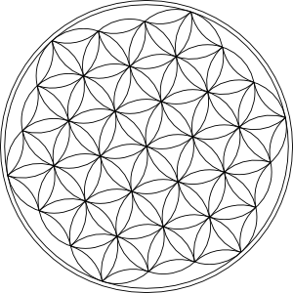
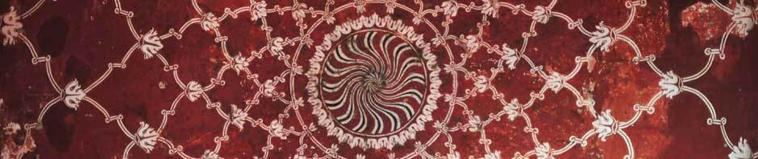
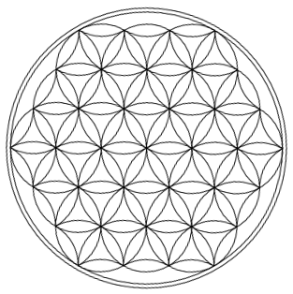

World conscious
Opposites the biggest SORROW
must stay the biggest happiness

Slide 3

Index
World tears, happiness, and dynamics
Connection, ideals, and status 2010
Repair, maintenance, and management
Global Human Commons organization
Living in harmony with nature
New Human Rights

Slide 4
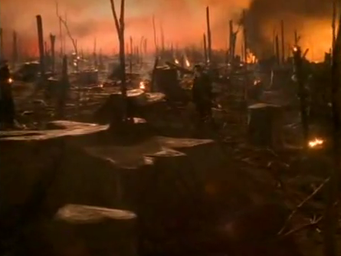
Biggest world sorrows
Poverty
Ignore
War
Illness
Lack
Suppression
Rape
Impotence

Slide 5
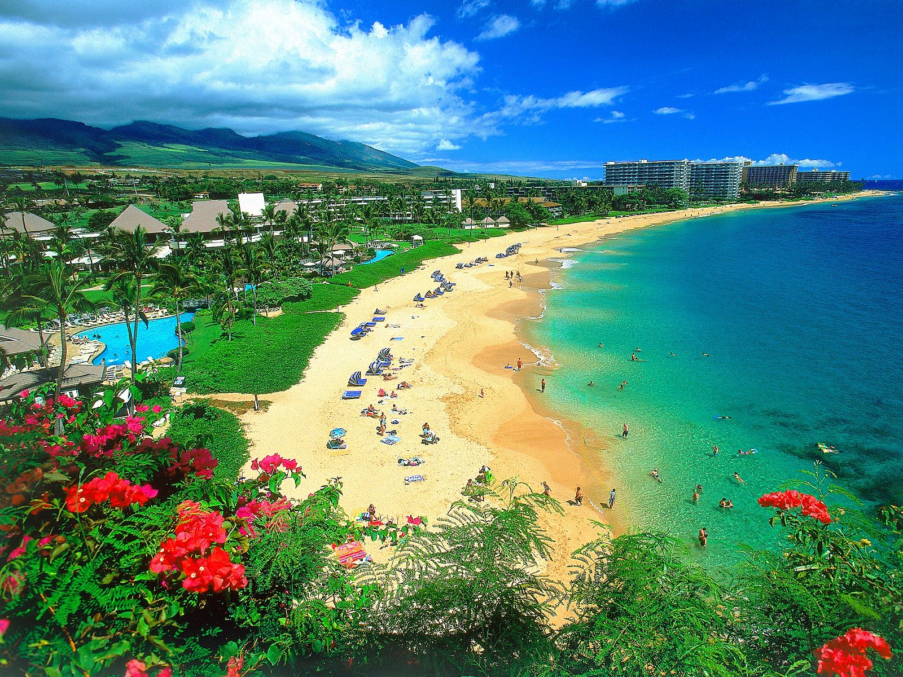
Grootste wereldgelukken
Abundance
Recognition
Peace
Health
Competence
Freedom
Service
Success

Slide 6
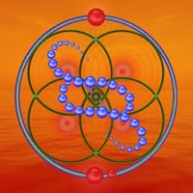
Order
Ignore → Impotence → Illness →
Lack → Poverty → War →
Suppression → Rape →
Competence → Recognition →
Peace → Success → Abundance →
Health → Freedom → Service →

Slide 7

Dynamics
All live
Universe
Spirituality
All
Self
Family
Group
Mankind

Slide 8
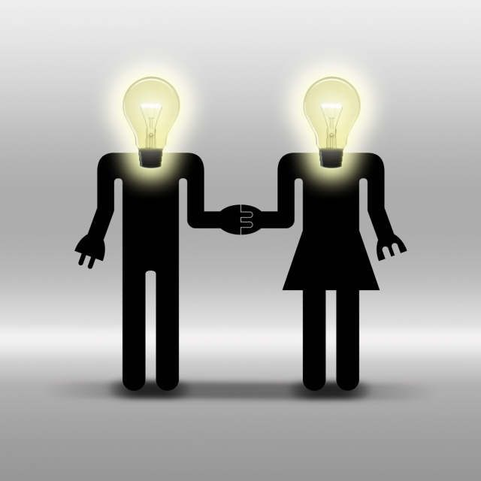
The connection
Love
Recognition
Communication
Affinity
Supervision
Responsibility

Slide 9
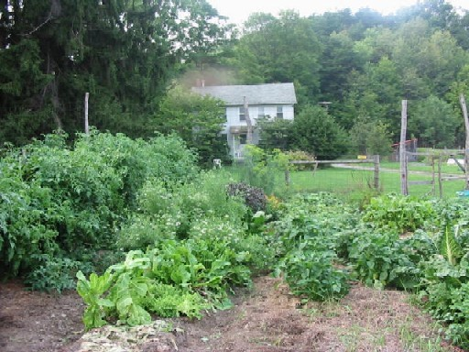
Ideal image
Self:
Family:
Group:
Manskind:
All life:
Universe:
Spirituality:
All:
Abundance
Recognition
Peace
Health
Competence
Freedom
Service
Success

Slide 10
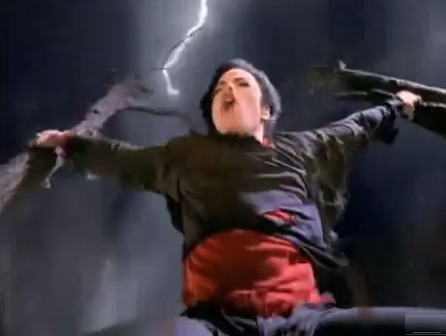
Situation 2010
Self:
Family:
Group:
Manskind:
All life:
Universe:
Spirituality:
All:
Ignore
Impotence
Illness
Lack
Suppression
Rape
Poverty
War
0 | 1 | 2 | 3 | 4 | 5
Recognition
Competition
Health
Abundance
Success
Peace
Freedom
Service
0 | 1 | 2 | 3 | 4 | 5
0 | 1 | 2 | 3 | 4 | 5
0 | 1 | 2 | 3 | 4 | 5
0 | 1 | 2 | 3 | 4 | 5
0 | 1 | 2 | 3 | 4 | 5
0 | 1 | 2 | 3 | 4 | 5
0 | 1 | 2 | 3 | 4 | 5

Slide 11
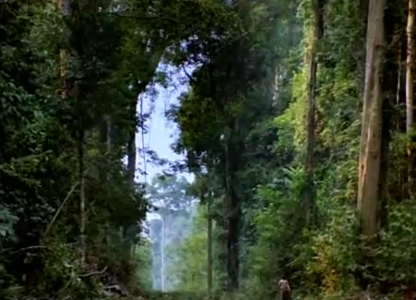
Restauratie
Self:
Family:
Group:
Manskind:
All life:
Universe:
Spirituality:
All:
Love
Recognition
Communication
Affinity
Supervision
Responsibility
Ignore
Impotence
Illness
Lack
Suppression
Rape
Poverty
War
Onderwijs
Training
Gewoonten
Verdeling
Onderhoud
Spelen
Saamhorigheid
Erkenning
Recognition
Competition
Health
Abundance
Success
Peace
Freedom
Service
0 | 1 | 2 | 3 | 4 | 5
0 | 1 | 2 | 3 | 4 | 5
0 | 1 | 2 | 3 | 4 | 5
0 | 1 | 2 | 3 | 4 | 5
0 | 1 | 2 | 3 | 4 | 5
0 | 1 | 2 | 3 | 4 | 5
0 | 1 | 2 | 3 | 4 | 5
0 | 1 | 2 | 3 | 4 | 5

Slide 12
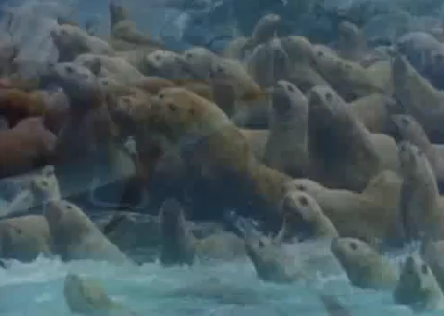
Restauratie
Onderwijs: Leraren, boeken, internet, groepen
Training: Oefenlessen, stages, praktijkervaring
Gewoonten: Communicatie, voeding, werk
Verdeling: Bezitsrechten, vruchtgebruik
Onderhoud: Sociaal, zelf, commons, kapitaal
Spelen: Muziek, sport, kunst, ontwikkeling
Saamhorigheid: Projecten, bestuur, festivals
Erkenning: Behoeften, hulp, support

Slide 13
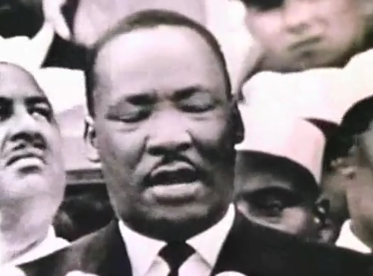
Onderhoud
Self:
Family:
Group:
Manskind:
All life:
Universe:
Spirituality:
All:
Love
Recognition
Communication
Affinity
Supervision
Responsibility
Ignore
Impotence
Illness
Lack
Suppression
Rape
Poverty
War
Testen en bijscholing
Testen en training update
Meten, evalueren, bijstellen
Verzorging en herverdeling
Onderhoud en bijstand
Melding, mediatie, spelen
Melding, mediatie, spelen
Melding, mediatie, spelen
Recognition
Competition
Health
Abundance
Success
Peace
Freedom
Service
0 | 1 | 2 | 3 | 4 | 5
0 | 1 | 2 | 3 | 4 | 5
0 | 1 | 2 | 3 | 4 | 5
0 | 1 | 2 | 3 | 4 | 5
0 | 1 | 2 | 3 | 4 | 5
0 | 1 | 2 | 3 | 4 | 5
0 | 1 | 2 | 3 | 4 | 5
0 | 1 | 2 | 3 | 4 | 5

Slide 14
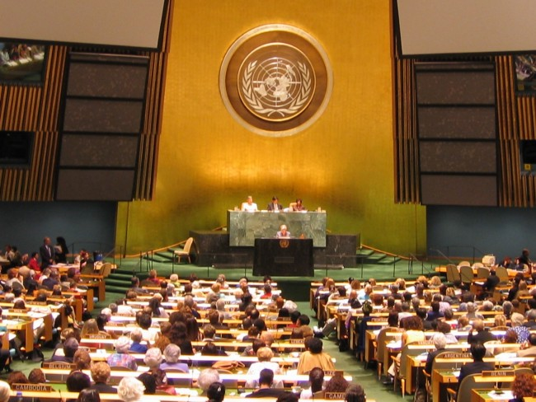
Beheer
Self:
Family:
Group:
Manskind:
All life:
Universe:
Spirituality:
All:
Love
Recognition
Communication
Affinity
Supervision
Responsibility
Ignore
Impotence
Illness
Lack
Suppression
Rape
Poverty
War
Wijsheidswolk, behoefte, deling
Monitoring, normering, training
Kadering, behoeften, sturing
Matching, overleg, verdeling
Monitoring, overleg, projecten
Monitoring, rapportage, projecten
Monitoring, rapportage, projecten
Monitoring, rapportage, projecten
Recognition
Competition
Health
Abundance
Success
Peace
Freedom
Service
0 | 1 | 2 | 3 | 4 | 5
0 | 1 | 2 | 3 | 4 | 5
0 | 1 | 2 | 3 | 4 | 5
0 | 1 | 2 | 3 | 4 | 5
0 | 1 | 2 | 3 | 4 | 5
0 | 1 | 2 | 3 | 4 | 5
0 | 1 | 2 | 3 | 4 | 5
0 | 1 | 2 | 3 | 4 | 5

Slide 15
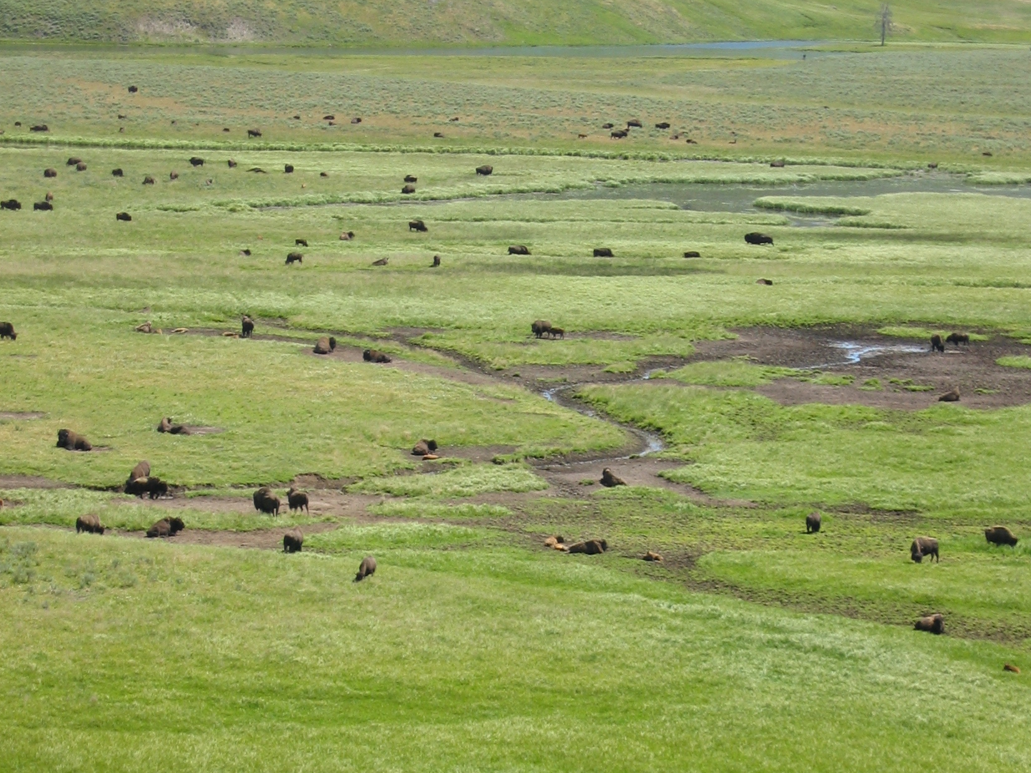
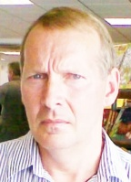
Global Human Commons What about us?
This community unions people all over the world to create the next step in society building, conscious development, and global evolution:
When we create common habitat, we will have the fundament for competition-less life time and has insurance for sustainability, peace, and good living.

Slide 16
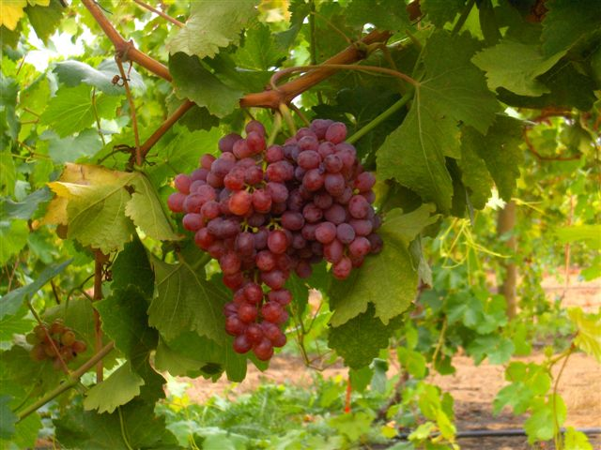
Global Human Commons What about us?
Like the birds have the sky and food,
and fishes have the waters and food,
mankind will have "free" housing, food, education, and recreation.

Slide 17
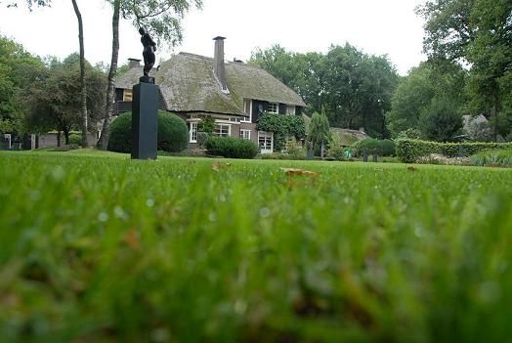
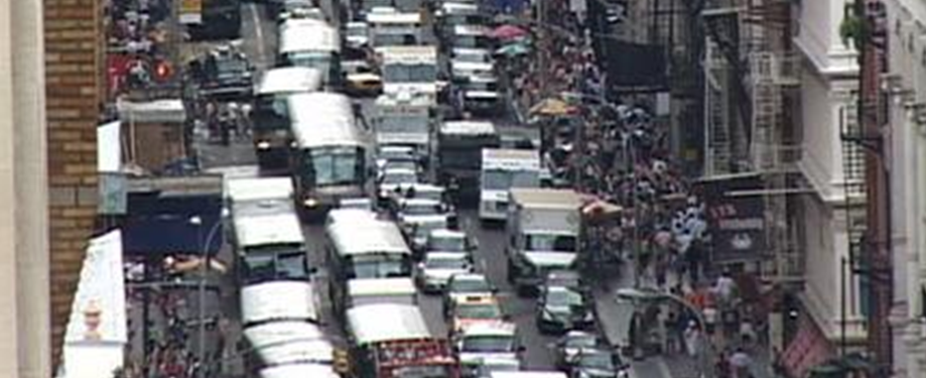
Living In Harmony With Nature
Global Human Commons likes to add new Human Rights that ensure habitat, sources of living and sustainability.
Nature is our source of life. However: In our daily battle to survive the “grosso modo” of humanity is only connected by economy.

Slide 18
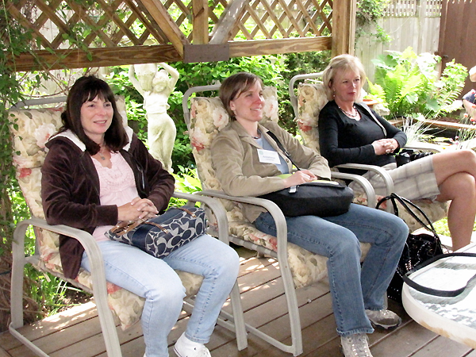
Global Human Commons What about us?
In my point of view we can find our evolved way to nature by overcoming the effects of the dark millennium by learning form it and shifting to primarily sharing and owning instead of owning by (economically) battle.
This is possible by layering our rights and sources in a more clever way:

Slide 19
Global Human Commons What about us?
First the basement of (human and all) life must be granted by common nature;
Then man needs from birth right to owns an own place to live and to harvest so s/he will have a valuable crib;
On the third layer comes the right to take care for nature and neighbors as well to get care by inability and age;
The fourth layer will grand education and entrepreneurship in free economy based on green technology;

Slide 20
Global Human Commons What about us?
From those four layers mankind will be able to live in peace and harmony with nature by finding the right proportions for this by becoming aware of interrelationships as population, food, rich natural environment, and spiritual emotional balance.

Slide 21
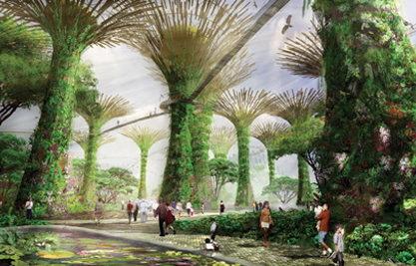
Global Human Commons What about us?
So the power of this shift is to get people back in connection with nature as well out of the economical battle by commons and birth right on land and harvest.
This we call THE BRONNING RIGHTS. In 1948 the United Nations adopted the Universal Declaration of the Human Rights. It contains 30 rights. Up to ten additional rights will grand the bronning rights. So the new Human Rights “2012” will be 40 in number. To add:

Slide 22
Global Human Commons What about us?
31. A part of the global land and water will be common wealth to ensure sustainability of nature and species.
32. Everyone has the right to visit (parts of) common nature.
33. Everyone gets (for instance) 1000 m2 of fertile land on which enough sun and water enters to produce good food and a healthy living.
34. Everyone gets the right and duty to get and give care to the commons and peoples with inabilities and at age as a local service – part of lifetime activity.

Slide 23
Global Human Commons What about us?
35. Everyone gets free energy in an reasonable amount to has good light, heating and cooling, cleaning, internet, and telephone.
36. Everyone gets a pollution quote and the right on healthy air and surrounding.
37. Everyone has the right on correct information and sufficient education.

Slide 24
Global Human Commons What about us?
38. Everyone has the right to work on four levels – based on green technology: On his own land; On community services; On social services; On commercial services.

Slide 25
Global Human Commons What about us?
39. Everyone has the right to (let) labor his land, build a house on it and to exchange with others. After dying the land may stay for five year in the family. Then it will be free for giving it away to the community which will give it to a new born child.
40. Mankind has the right to live in peace and harmony with nature by finding ether the right proportions for the above by becoming aware of interrelationships as population, food, rich natural environment, and the needed spiritual emotional balance.

Slide 26
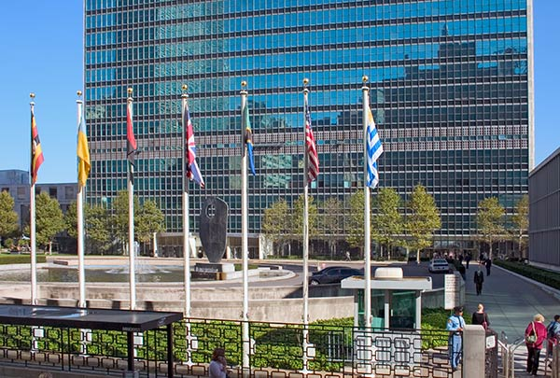
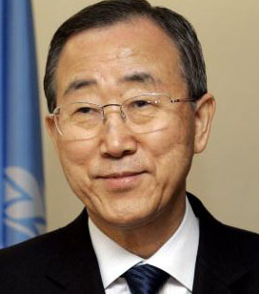
Global Human Commons What about us?
This BRONNING RIGHTS were presented on July 15th, 2010 to the U.N. Secretary-General Ban Ki-moon by emailing it in a letter to his Speech writers and on July 20th to Inquiries.
Letter to the S-G, 64/196, U.N. GA 65 session, HQ, 14 September 2010, at 3 p.m., Agenda point 20(i).

Slide 27
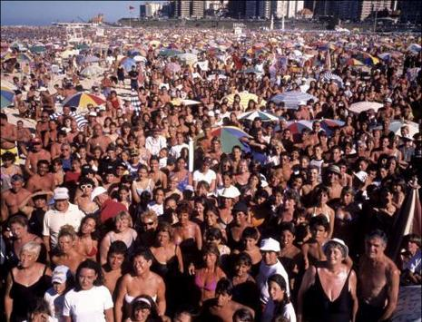
Global Human Commons What about us?
In 1948 the United Nations adopted the Universal Declaration of the Human Rights. It contains 30 rights. In short it handles:
1. FREEDOM AND EQUALTY
2. RECOGNITION AND LAW
3. FREEDOM OF MOVEMENT AND NATIONALITY
4. MARRIAGE AND FAMILY
5. PROPERTY, THOUGHT, ASSOCIATION AND GOVERNMENT
6. SOCIAL SECURITY, EMPLOIMENT AND REMUNERATION
7. STANDARD LIVING AND EDUCATION
8. CULTURAL PARTICIPATION AND CREATIVE OWNERSHIP
9. SOCIAL AND COMMUNITY DUTIES
10. BRONNING RIGHTS (Additive 2012 ?)

Slide 28
Beheer
Self:
Family:
Group:
Manskind:
All life:
Universe:
Spirituality:
All:
Love
Recognition
Communication
Affinity
Supervision
Responsibility
Ignore
Impotence
Illness
Lack
Suppression
Rape
Poverty
War
Wijsheidswolk, behoefte, deling
Monitoring, normering, training
Kadering, behoeften, sturing
Matching, overleg, verdeling
Monitoring, overleg, projecten
Monitoring, rapportage, projecten
Monitoring, rapportage, projecten
Monitoring, rapportage, projecten
Recognition
Competition
Health
Abundance
Success
Peace
Freedom
Service
0 | 1 | 2 | 3 | 4 | 5
0 | 1 | 2 | 3 | 4 | 5
0 | 1 | 2 | 3 | 4 | 5
0 | 1 | 2 | 3 | 4 | 5
0 | 1 | 2 | 3 | 4 | 5
0 | 1 | 2 | 3 | 4 | 5
0 | 1 | 2 | 3 | 4 | 5
0 | 1 | 2 | 3 | 4 | 5

Slide 29
Situation 2010
Self:
Family:
Group:
Manskind:
All life:
Universe:
Spirituality:
All:
Ignore
Impotence
Illness
Lack
Suppression
Rape
Poverty
War
0 | 1 | 2 | 3 | 4 | 5
Recognition
Competition
Health
Abundance
Success
Peace
Freedom
Service
0 | 1 | 2 | 3 | 4 | 5
0 | 1 | 2 | 3 | 4 | 5
0 | 1 | 2 | 3 | 4 | 5
0 | 1 | 2 | 3 | 4 | 5
0 | 1 | 2 | 3 | 4 | 5
0 | 1 | 2 | 3 | 4 | 5
0 | 1 | 2 | 3 | 4 | 5

Slide 30
Restauratie
Self:
Family:
Group:
Manskind:
All life:
Universe:
Spirituality:
All:
Love
Recognition
Communication
Affinity
Supervision
Responsibility
Ignore
Impotence
Illness
Lack
Suppression
Rape
Poverty
War
Onderwijs
Training
Gewoonten
Verdeling
Onderhoud
Spelen
Saamhorigheid
Erkenning
Recognition
Competition
Health
Abundance
Success
Peace
Freedom
Service
0 | 1 | 2 | 3 | 4 | 5
0 | 1 | 2 | 3 | 4 | 5
0 | 1 | 2 | 3 | 4 | 5
0 | 1 | 2 | 3 | 4 | 5
0 | 1 | 2 | 3 | 4 | 5
0 | 1 | 2 | 3 | 4 | 5
0 | 1 | 2 | 3 | 4 | 5
0 | 1 | 2 | 3 | 4 | 5

Slide 31
Transition What about us?

Slide 32
Implementation What about us?

Slide 33
Implementation What about us?

Slide 34

De verbinding
Liefde
Erkenning
Communicatie
Verantwoordelijkheid
Toezicht
Affiniteit

