Slide 1
SDF SUSTAINABLE DEVELOPMENT FINANCE
WSF 2014-08-08
INTRODUCTION TO THE PROPOSAL OF THE INTERGOVERNMENTAL COMMITTEE OF EXPERTS ON SUSTAINABLE DEVELOPMENT FINANCE

Slide 2
SDF Outcome document - Index
I. Procedural Introduction to the Report on the work of the ICESDF
II. Organizational matters III. Introduction
IV. The global context
A. A changing global context
B. The scope of financing needs
C. Emerging patterns of resource flows
V. Strategic approach
VI. Options for an integrated sustainable development financing strategy
A. Domestic public financing
B. Domestic private financing
C. International public financing
D. International private financing
E. Blended finance
VII. Global governance for financing sustainable development
VIII. Concluding remarks

Slide 3
I. Procedural Introduction to the Report
In Resolution 66/288 of 11 Sept. 2012, the General Assembly endorsed the outcome of the U.N. Conference on Sustainable Development “The future we want”.
In Resolution 67/203 of 27 Feb. 2013, the GA requested the intergovernmental committee to provide an update on the progress of its work before the beginning of the sixty-eighth session of the Assembly.
By its decision 67/559 of 18 June 2013, the GA welcomed the Committee’s membership comprised of 30 experts as nominated by the five regional groups of the U.N.

Slide 4
II. Organizational matters
A. Organization of work
B. Opening
C. Election of officers
D. Agenda
E. Modalities of work
F. Proceedings of the Intergovernmental Committee of Experts
G. Adoption of the report of the Intergovernmental Committee of Experts

Slide 5
A. Organization of work
Sessions were held as follows: first session (28-30 August 2013, six formal meetings); second session (2-6 December 2013, ten formal meetings); third session (3-7 March 2014, nine formal meetings); fourth session (12-16 May 2014, ten formal meetings) and fifth session (4-8 August 2014, ___ formal meetings).

Slide 6
B. Opening
On 28 August 2013, the Acting President of the sixty-seventh session of the General Assembly (Peru) opened the session and made a statement. A statement was also made by the Assistant Secretary-General for Economic Development on behalf of the Under-Secretary-General for Economic and Social Affairs.

Slide 7
C. Election of officers
At its first meeting of the first session on 28 August 2013, the Committee elected Pertti Majanen (Finland) and Mansur Muhtar (Nigeria) as its Co- Chairs by acclamation.

Slide 8
D. Agenda
At the same meeting, the Committee adopted the provisional agenda (A/AC.282/2013/1), which read:
1. Election of officers.
2. Adoption of the agenda and other organizational matters.
3. Follow-up to the outcome of the United Nations Conference on Sustainable Development, relating to the reparation of a report proposing options on an effective sustainable development financing strategy to facilitate the mobilization of resources and their effective use in achieving sustainable development objectives.
4. Other matters.
5. Adoption of the report.

Slide 9
E. Modalities of work
At the same meeting, the Committee adopted its modalities of work.
At the 3rd meeting of its first session, on 29 August 2013, the Committee agreed to organize its work into three clusters of topics, as follows:
Assessing financing needs, mapping of current flows and emerging trends, and the impact of domestic and international environments
Mobilization of resources and their effective use:
a) Domestic resources (public and private): increasing effectiveness and mobilizing
additional resources
b) External resources (public and private): increasing effectiveness and mobilizing
additional resources
c) Blended finance (domestic and international) and new initiatives
Institutional arrangements, policy coherence, synergies and governance issues

Slide 10
F. Proceedings of the Intergovern-mental Committee of Experts - 1
Closed meetings
Pursuant to its modalities of work, the Committee conducted the majority of its work in closed plenary meetings, in an interactive format.
Open meetings
A briefing to the General Assembly on the work of the Committee (pursuant to paragraph 7 of General Assembly resolution 67/203) was held on 30 August 2013. The Committee also held an open briefing on the progress of the Committee’s work on 16 May 2014.

Slide 11
F. Proceedings of the Intergovern-mental Committee of Experts - 1
Interactive multistakeholder dialogues with Member States, intergovernmental organizations, NGOs, business sector and other Major Groups engaged in the Rio+20 Conference, the Financing for Development process and the post-2015 development agenda were held on 5 December 2013, 3 March, 12 May, 18 July and 5 August 2014. The multistakeholder dialogues were preceded by open briefings.
A joint meeting with the Open Working Group on Sustainable Development Goals was held on 5 March 2014.
Other meetings
The Committee held regional outreach meetings in Santiago de Chile (Latin America and Caribbean), in Helsinki, Finland (Europe), Addis Ababa, Ethiopia (Africa), Jeddah, Saudi Arabia (Arab region), and in Jakarta, Indonesia (Asia). In addition, numerous informal outreach events and multi-stakeholder dialogues were organized in different locations, including events with the international financial institutions.

Slide 12
G. Adoption of the report of the Inter-governmental Committee of Expert
(15) At its __th meeting of its fifth session, on 8 August 2014, the Committee adopted its draft report (contained in document A/CONF.282/2014/__), and entrusted the Co- Chairs, in collaboration with the Secretariat, to forward the report to the General Assembly for its consideration.

Slide 13
III. Introduction - 1
The Monterrey Consensus of the International Conference on Financing for Development provided a basis for our analysis, with its emphasis on the use of all forms of financing ...
However, we also recognized the need to update this framework to meet the challenges of the post-2015 development agenda.
In this regard, we were mindful of the work of the Open Working Group on Sustainable Development Goals, and ... the post-2015 development agenda ...

Slide 14
III. Introduction - 2
Our work concludes that there is no one simple policy solution. Instead, a basket of policy measures will be necessary, encompassing a toolkit of policy options, regulations, institutions, programs and instruments ...
We find that a concerted effort that draws on all actors and mobilizes all resources in an integrated manner, while maximizing their impact, will allow us to finance the investments necessary to achieve sustainable development for all.

Slide 15
IV. The global context
A. A changing global context
B. The scope of financing needs
C. Emerging patterns of resource flows

Slide 16
A. A changing global context - 1
Since the adoption of the Millennium Declaration in 2000, many developing countries have experienced significantly faster economic growth than developed economies. ...
Despite these achievements, there are differences between and within countries, and much unfinished business remains to realize all of the MDGs. ...

Slide 17
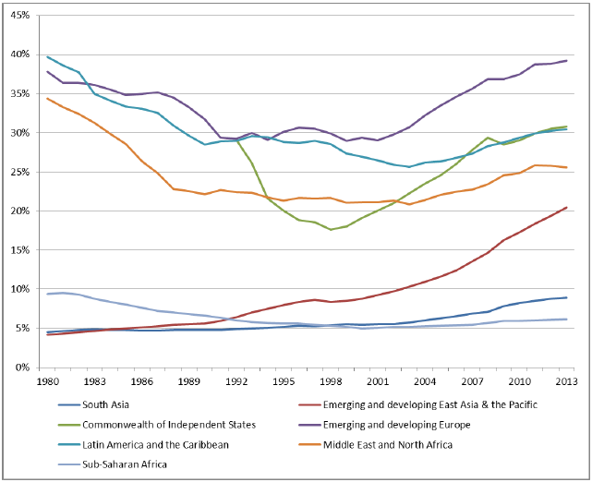
Figure 1: GDP per capita, relative to advanced economies

Slide 18
A. A changing global context - 3
(30) Risks and vulnerabilities have also become more pronounced. Environmental degradation, climate change, natural disasters and other threats to the global environment (such as oceans, forests and biodiversity), pose additional challenges to the ability of all countries, and developing countries in particular, to achieve sustainable development. ...

Slide 19
A. A changing global context - 4
... The global economic and financial crisis revealed risks within the international financial system, as well as the vulnerability of countries to external financial traumas, adversely impacting their capacity to mobilize resources for development.

Slide 20
B. The scope of financing needs
Against this backdrop, financing needs for poverty eradication and sustainable development remain significant. These include addressing
i) basic needs related to eradicating poverty and hunger, improving health and education, providing access to affordable energy and promoting gender equality;
ii) national sustainable development investment financing needs, such as for infrastructure, rural development, adaptation and climate resilient development, and energy; and
iii) global public goods, including the protection of the global environment and combatting climate change and its impact, as well as other areas.

Slide 21
B. The scope of financing needs
Quantifying needs is complex and necessarily imprecise, since estimates are dependent on a host of assumptions including the macroeconomic and policy environment – at sector and economy-wide levels – and international rules, norms and standards.
With regards to social needs, a rough estimate of the cost of a global safety net to eradicate extreme poverty in all countries (measured as increasing incomes of the poorest to the $1.25 a day standard) is around $66 billion annually.
There are also vast financing needs for the provision of global public goods. The order of magnitude of additional investment requirements for “climate-compatible” and “sustainable development” scenarios (which include goals and targets related to climate) are estimated to be of the order of several trillion dollars per year (see Figure 2)

Slide 22
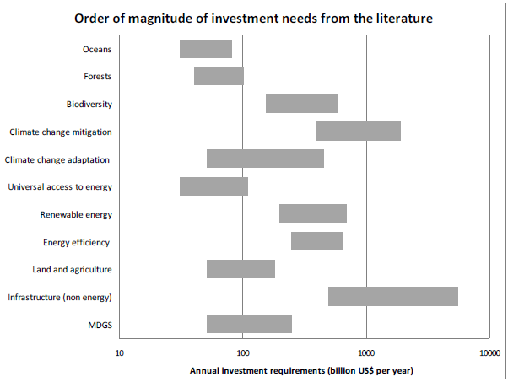
B. The scope of financing needs

Slide 23
C. Emerging patterns of resource flows
Despite large needs, the emerging patterns of resource flows highlight the opportunities for mobilizing financing needed to support the achievement of sustainable development. Global savings remain robust, at around US$ 22 trillion a year (inclusive of public and private sources), despite a temporary decline due to the crisis. The stock of global financial assets – a placement for only a small portion of annual global savings – is estimated to be around US$ 218 trillion. Even a small shift in the way resources are allocated would have an enormous impact.
All four types of finance - public and private, domestic and international – have increased since 2002. Domestic finance has grown rapidly in recent years, representing by far the greatest share of financing sources for most countries (see Figure 3). In many developing countries, particularly in LDCs, public international finance remains crucial.

Slide 24
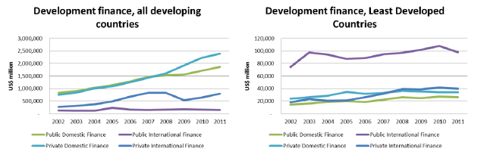
C. Emerging patterns of resource flows
Figure 3: Development finance in developing countries and Least Developed Countries

Slide 25
C. Emerging patterns of resource flows
International financial flows to developing countries increased rapidly over the last decade, mainly driven by growth in private capital flows and remittances, though official development assistance (ODA) also strengthened, as depicted in Figure 4.

Slide 26
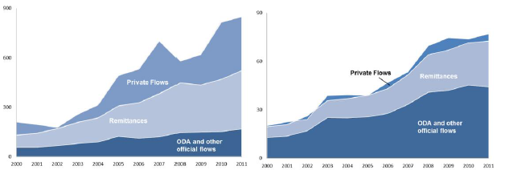
C. Emerging patterns of resource flows
Figure 4: Financing flows to Developing Countries (left) and Least Developed Countries (right), in billions of US$

Slide 27
C. Emerging patterns of resource flows
International financial flows to developing countries increased rapidly over the last decade, mainly driven by growth in private capital flows and remittances, though official development assistance (ODA) also strengthened, as depicted in Figure 4.

Slide 28
C. Emerging patterns of resource flows
International financial flows to developing countries increased rapidly over the last decade, mainly driven by growth in private capital flows and remittances, though official development assistance (ODA) also strengthened, as depicted in Figure 4.

Slide 29
C. Emerging patterns of resource flows
International financial flows to developing countries increased rapidly over the last decade, mainly driven by growth in private capital flows and remittances, though official development assistance (ODA) also strengthened, as depicted in Figure 4.

Slide 30
C. Emerging patterns of resource flows Public domestic resource mobilization
Public domestic finance in developing countries more than doubled between 2002 and 2011, increasing from US$ 838 billion to US$ 1.86 trillion.
In many countries, tax evasion and avoidance hinder domestic resource mobilization. In addition, illicit financial outflows, including tax evasion across borders, have undermined tax collection.
Domestic public resources are also impacted by subsidies. For example, in 2011 pre-tax energy subsidies amounted to US$ 480 billion, primarily in developing countries, and post-tax energy subsidies amounted to $1.9 trillion, primarily in developed countries.

Slide 31
C. Emerging patterns of resource flows Public domestic resource mobilization
There has been considerable change in the landscape of sovereign debt of developing countries since the Millennium Declaration. External debt amounted to 22.6 per cent of GDP in developing countries in 2013, as compared to 33.5 per cent a decade earlier.
Some countries covered under HIPC have begun to issue debt on international markets, facilitated by a low interest rate environment.
Nonetheless, the aggregate picture masks growing debt problems in some countries.

Slide 32
C. Emerging patterns of resource flows Domestic private finance
Financial systems in many developing countries rely primarily on the banking sector. Though domestic credit has grown substantially over the past decade, in many countries, banking sector credit is primarily short-term.
Domestic bond markets have also grown substantially, driven primarily by sovereign debt issues. Corporate bond markets, though growing, remain small.
The presence of institutional investors in developing countries has, however, been growing, and could potentially increase resources available for long-term investment in sustainable development.
There is also a growing emphasis on the environmental, social, and governance impacts of investments.

Slide 33
C. Emerging patterns of resource flows International public finance
The development contribution of ODA improved in the wake of the adoption of the Monterrey Consensus in 2002, with increased attention paid to making ODA more effective while increasing its volume. ODA reached an all-time high of US$ 134.8 billion in net terms in 2013, after falling in 2011 and 2012. Nonetheless, only 5 OECD DAC donors reached the 0.7per cent of gross national income target.
ODA continues to provide essential financial and technical cooperation to many developing countries (see Figure 4), including least developed countries and many African countries, landlocked developing countries, small island developing states, and countries affected by conflict. In most countries with government spending of less than PPP$ 500 per person per year, ODA accounts for an average of more than two-thirds of international resource flows, and about one-third of government revenues.

Slide 34
C. Emerging patterns of resource flows International public finance
The Leading Group on Innovative Financing for Development has pioneered on a voluntary basis a number of fund-raising mechanisms to raise additional resources, including the international solidarity levy on air tickets.
There has also been a proliferation of sustainable development related international funds and delivery channels.
Only ten years ago, multilateral climate finance was provided by a small number of large funds, which were associated with the United Nations Framework Convention on Climate Change (UNFCCC). There are now over 50 international public funds.

Slide 35
C. Emerging patterns of resource flows Int. trade & cross-border private finance
Global trade also continues to grow, albeit at a slower pace than before the international financial and economic crisis, and trade flows have assumed increased importance for resource mobilization in many developing countries. For LDCs, the average trade-to-GDP ratio has risen from 38 per cent in 1990 to 70 per cent in 2011.
Gross flows of FDI to developing countries reached $ 778 billion in 2013, exceeding FDI to developed economies.
The nature of international portfolio investment in emerging markets has evolved over the past fifteen years, as many countries’ markets have deepened and become more globally integrated.

Slide 36
C. Emerging patterns of resource flows Int. trade & cross-border private finance
Private cross-border transfers from individuals and households have also grown substantially. An estimated US$ 404billion was remitted to developing countries from migrants in 2013, representing a more than ten-fold increase in recorded remittances from 1990, when they were estimated at less than US$40 billion.
A portion of international inflows has been used by some countries to build foreign exchange reserves, in part as a form of self-insurance against the volatility of international capital flows. Foreign exchange reserves increased from $2.1 trillion to $11.7 trillion from 2000 to 2013. Developing countries, primarily emerging market countries, hold almost $8 trillion, with the top five emerging market countries holding around 65 per cent of this.

Slide 37
V. Strategic approach
Figure 5 illustrates the analytical framework that has guided us in formulating this sustainable development financing strategy. Financial sources can be arranged into four categories: domestic public, domestic private, international public and international private sectors. The challenge for policymakers is to channel and incentivize more of these diverse and decentralized sources of financing into desired investments in sustainable development.
As depicted in Figure 5, financing decisions, in all cases, whether public or private, are influenced by national policy frameworks and the international financial architecture, the extent of appropriate and effective financing institutions, and the design and development of instruments to facilitate and help overcome impediments to investment in sustainable development. In this spirit, the following precepts guide our strategic approach.

Slide 38
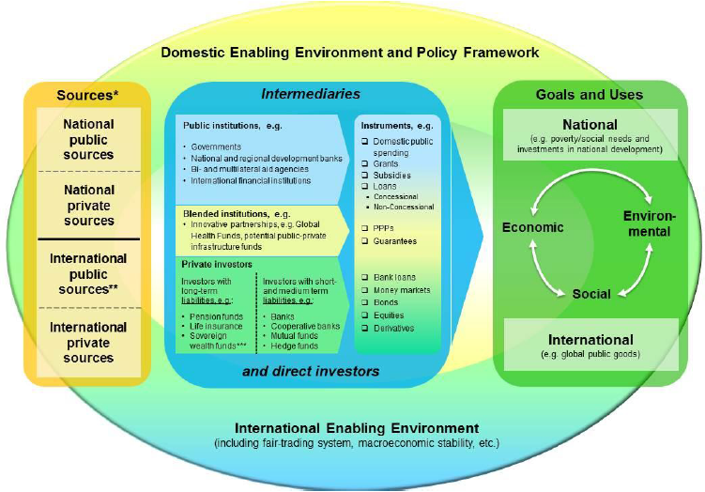
Figure 5: Flows of funds from int. and national financing sources to SD

Slide 39
V. Strategic approach
Ensure country ownership and leadership in implementing national sustainable development strategies, along with a supportive international environment.
Adopt effective government policies as the lynchpin of a sustainable development financing strategy.
Make use of all financing flows in a holistic way.
Match financing flows with appropriate needs and uses.
Maximize the impact of international public finance.

Slide 40
V. Strategic approach
Mainstream sustainable development criteria in national financing strategies. Mainstream sustainable development criteria in national financing strategies.
Exploit synergies across the economic, environmental, and social dimensions of sustainable development.
Adopt a multi-stakeholder, people-centered and inclusive approach to achieve tangible results on the ground.
Ensure transparency and accountability of financing at national, regional and international levels.

Slide 41
VI. Options for an integrated sustainable development financing strategy
In each category of finance, decision-making is decentralized among the separate institutions and actors.
In what follows, we highlight particular policy areas pertaining to each of the four groups of financing sources, as well as blended finance, and suggest a toolkit of policy options and financial instruments, to be used within a cohesive national sustainable development strategy.

Slide 42
VI. Options for an integrated sustainable development financing strategy
A. Domestic public financing
B. Domestic private financing
C. International public financing
D. International private financing
E. Blended finance

Slide 43
A. Domestic public financing
There are three primary roles for domestic public finance: 1) increasing equity, including through poverty reduction; 2) providing public goods and services that markets will eschew or under-provide and enacting policies to change incentives of private actors; and 3) managing macroeconomic stability.
Promote tax reform, tax compliance and deeper int. cooperation
Domestic resource mobilization depends on many factors, such as size of tax base, a country’s capacity to collect and administer taxes, tax elasticity, the volatility of sectors being taxed, and commodity prices.

Slide 44
A. Domestic public financing
However, there are limits on what individual governments can accomplish on their own in the globalized economy
Whereas, to date, technical assistance to the revenue and customs sector has attracted a minimal share of ODA, going forward more focus should be placed in responding to national requests for strengthening fiscal management capacity and capacity building for domestic resource mobilization.
In resource-rich countries, the management of natural resources is particularly critical. Fiscal rules governing the extractive industries should ensure that the public interest is appropriately compensated.

Slide 45
A. Domestic public financing
Ensure good financial governance and public financial management
Combating corruption plays an important part in complementing efforts to improve domestic revenue mobilization.
A central element of good financial governance is proper planning and execution of the budget. Generally accepted principles of good budgeting address the stages of formulation, approval, execution and audit.
It is common in normative budget policy discussions to ask if specific subsidies continue to be warranted. Countries should review the efficacy of all subsidies as a matter of sound fiscal management.

Slide 46
A. Domestic public financing
Similarly, countries should correct and prevent trade restrictions and distortions in world agricultural markets, including by the parallel elimination of all forms of agricultural export subsidies and all export measures with equivalent effect, in accordance with the mandate of the Doha Development Round.
Procurement systems need further strengthening in many countries to ensure fair competition. As part of budget execution, authorities may wish to align their procurement policies with national sustainable development strategies, which implies defining minimum environmental and social standards for public sector suppliers, taking into account domestic situations.

Slide 47
A. Domestic public financing
Financial auditing and control should be complemented by monitoring and evaluation of economic, social and environmental impacts, in line with country capacities and circumstances.
Internalize externalities and mainstream environmental sustainability
There is a large potential role for fiscal reforms in promoting environmental sustainability. Policy measures such as “cap and trade” and carbon taxes seek to curb carbon emissions by raising the price of emissions and “internalize externalities”. Carbon markets remain relatively small, however, with only 7 per cent of the world’s emissions covered.

Slide 48
A. Domestic public financing
Governments should also consider other policies to change investment patterns, such as direct emission restrictions on investments, subsidizing research and development of clean technologies, including carbon capture and storage technologies, tax incentives, feed-in tariffs, energy efficiency or renewable energy targets, pollution rights, and payments for ecosystem services.
Address inequity and the social protection imperative
Governments should use fiscal policies (both tax and spending) to address inequalities, fight poverty, improve water and sanitation, and support other social services, in particular to benefit low income, vulnerable and marginalized groups. A frequent call is to give priority to public investment projects that are “pro-poor” and gender sensitive.

Slide 49
A. Domestic public financing
Structural vulnerabilities, which affect the poor and other socially excluded groups, women, persons with disabilities, indigenous peoples, migrants, minorities, children, older persons, youth and other marginalized groups, can be reduced by aiming for universal provision of basic social services.
In addition to offering protection against risks, social protection can contribute to equitable growth by reducing poverty and inequality, raising labour productivity, and enhancing social stability
Productive and decent employment is the most important form of income security. Most people rely on earnings from work as their main source of income.

Slide 50
A. Domestic public financing
Effectively manage public debt
Debt financing can represent a viable option to provide funding for public spending on sustainable development. At the same time, debt needs to be effectively managed, with the goal of ensuring that debt obligations can be serviced under a wide range of circumstances. Governments should make regular use of analytical tools to assess alternative borrowing strategies.
The International financial institutions and the UN system have been developing standards for prudent management of government debt. Countries that have already reached a high level of debt need to ensure that the growth of public debt does not exceed expected GDP growth to avoid financial distress.

Slide 51
A. Domestic public financing
Explore the potential contributions of national development banks
In the absence of sufficient long-term private sector financing and investment in sustainable development, many countries have established national development banks (NDBs) and other public institutions to support long-term investment. The combined assets of the IDFC, a group of 20 national, bilateral, and regional development banks, amount to over $ 2.1 trillion in 2010.
Governments can use NDBs to strengthen capital markets and leverage investments in sustainable development. For example, some NDBs finance (part of) their activities through the issuance of bonds that allocate funds raised to a particular use, such as green infrastructure with the proceeds allocated to specific classes of investment (e.g. green bonds).

Slide 52
A. Domestic public financing
There are, however, challenges for policymakers with regard to NDBs. Policymakers should ensure that public development banks do not undertake activities that the private sector will competitively provide. Importantly, provisions should be in place to avoid inappropriate political interference with the operation of the bank, and to ensure efficient use of resources, particularly with regard to leveraging private sector investment in sustainable development.

Slide 53
B. Domestic private financing
In understanding the role of the private sector in financing sustainable development, it is important to recognize that the private sector includes a wide range of diverse actors, from households to multinational corporations and from direct investors to financial intermediaries, such as banks and pension funds. Private resources have historically been a key driver of domestic growth and job creation.
...

Slide 54
C. International public financing

Slide 55
D. International private financing

Slide 56
E. Blended finance

Slide 57
VII. Global governance for financing sustainable development

Slide 58
VIII. Concluding remarks

Slide 59
I. Procedural Introduction to the Report on the work of the ICESDF
II. Organizational matters III. Introduction
IV. The global context
A. A changing global context
B. The scope of financing needs
C. Emerging patterns of resource flows
V. Strategic approach
VI. Options for an integrated sustainable development financing strategy
A. Domestic public financing
B. Domestic private financing
C. International public financing
D. International private financing
E. Blended finance
VII. Global governance for financing sustainable development
VIII. Concluding remarks

Slide 60
I. Procedural Introduction to the Report on the work of the ICESDF
II. Organizational matters III. Introduction
IV. The global context
A. A changing global context
B. The scope of financing needs
C. Emerging patterns of resource flows
V. Strategic approach
VI. Options for an integrated sustainable development financing strategy
A. Domestic public financing
B. Domestic private financing
C. International public financing
D. International private financing
E. Blended finance
VII. Global governance for financing sustainable development
VIII. Concluding remarks

Slide 61
sustainable development Finance
…

Slide 62
worldsustainabilityfund.nl
Contact emile@worldsustainabilityfund.nl Skype: sbfemile
Tel: +31 6 1925 2628

